Slide 1
Module #20:
Graph Theory
(c)2001-2003, Michael P. Frank, revised by S. Kang

Slide 2

What are Graphs?
Not
General meaning in everyday math:
A plot or chart of numerical data using a coordinate system.
Technical meaning in discrete mathematics:
A particular class of discrete structures (to be defined) that is useful for representing relations and has a convenient webby-looking graphical representation.
Not Our
Meaning
(c)2001-2003, Michael P. Frank, revised by S. Kang

Slide 3
Simple Graphs
Correspond to symmetric,
irreflexive binary relations R.
A simple graph G=(V,E)
consists of:
  a set V of vertices or nodes (V corresponds to the universe of the relation R),
  a set E of edges / arcs / links: unordered pairs of [distinct] elements u,v ∈ V, such that uRv.
Visual Representation
of a Simple Graph
(c)2001-2003, Michael P. Frank, revised by S. Kang

Slide 4
Example of a Simple Graph
Let V be the set of states in the far-southeastern U.S.:
  I.e., V={FL, GA, AL, MS, LA, SC, TN, NC}
Let E={{u,v}|u adjoins v}
  ={{FL,GA},{FL,AL},{FL,MS},
  {FL,LA},{GA,AL},{AL,MS},
  {MS,LA},{GA,SC},{GA,TN},
  {SC,NC},{NC,TN},{MS,TN},
  {MS,AL}}
TN
NC
MS
AL
SC
GA
LA
FL
(c)2001-2003, Michael P. Frank, revised by S. Kang

Slide 5
Multigraphs
Like simple graphs, but there may be more than one edge connecting two given nodes.
E.g., nodes are cities, edges
are segments of major highways.
Parallel
edges
(c)2001-2003, Michael P. Frank, revised by S. Kang

Slide 6
Directed Graphs
Correspond to arbitrary binary relations R, which need not be symmetric.
A directed graph (V,E) consists of a set of vertices V and a binary relation E on V.
E.g.: V = set of People,
E={(x,y) | x loves y}
(c)2001-2003, Michael P. Frank, revised by S. Kang

Slide 7
§8.2: Graph Terminology
You need to learn the following terms:
Adjacent, connects, endpoints, degree, initial, terminal, in-degree, out-degree, complete, cycles, wheel, n-cube, bipartite, subgraph, union.
(c)2001-2003, Michael P. Frank, revised by S. Kang

Slide 8
Adjacency
Let G be an undirected graph with edge set E. Let e∈E be (or map to) the pair {u,v}. Then we say:
u, v are adjacent / neighbors / connected.
Edge e is incident with vertices u and v.
Edge e connects u and v.
Vertices u and v are endpoints of edge e.
(c)2001-2003, Michael P. Frank, revised by S. Kang

Slide 9
Degree of a Vertex
Let G be an undirected graph, v∈V a vertex.
The degree of v, deg(v), is its number of incident edges.
A vertex with degree 0 is called isolated.
A vertex of degree 1 is called pendant.
(c)2001-2003, Michael P. Frank, revised by S. Kang

Slide 10
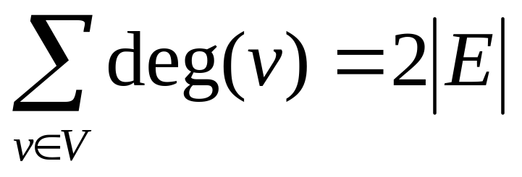
Handshaking Theorem
Let G be an undirected (simple or multi-) graph with vertex set V and edge set E. Then
Corollary: Any undirected graph has an even number of vertices of odd degree.
(c)2001-2003, Michael P. Frank, revised by S. Kang

Slide 11
Directed Adjacency
Let G be a directed graph, and let e be an edge of G that is (or maps to) (u,v). Then we say:
  u is adjacent to v, v is adjacent from u
  e comes from u, e goes to v.
  e connects u to v, e goes from u to v
  the initial vertex of e is u
  the terminal vertex of e is v
(c)2001-2003, Michael P. Frank, revised by S. Kang

Slide 12
Directed Degree
Let G be a directed graph, v a vertex of G.
  The in-degree of v, deg⁻(v), is the number of edges going to v.
  The out-degree of v, deg⁺(v), is the number of edges coming from v.
  The degree of v, deg(v):≡deg⁻(v)+deg⁺(v), is the sum of v’s in-degree and out-degree.
(c)2001-2003, Michael P. Frank, revised by S. Kang

Slide 13
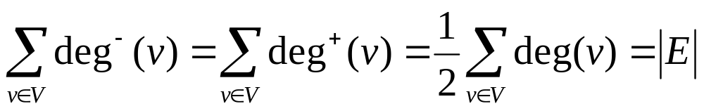
Directed Handshaking Theorem
Let G be a directed graph with vertex set V and edge set E. Then:
Note that the degree of a node is unchanged by whether we consider its edges to be directed or undirected.
(c)2001-2003, Michael P. Frank, revised by S. Kang

Slide 14
Special Graph Structures
Special cases of undirected graph structures:
Complete graphs K_{n}
Cycles C_{n}
Wheels W_{n}
n-Cubes Q_{n}
Bipartite graphs
Complete bipartite graphs K_{m,n}
(c)2001-2003, Michael P. Frank, revised by S. Kang

Slide 15
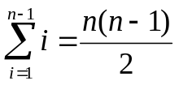
Complete Graphs
For any n∈N, a complete graph on n vertices, K_{n}, is a simple graph with n nodes in which every node is adjacent to every other node: ∀u,v∈V: u≠v↔{u,v}∈E.
K₁
K₂
K₃
K₄
K₅
K₆
Note that K_{n} has edges.
(c)2001-2003, Michael P. Frank, revised by S. Kang

Slide 16
Cycles
For any n≥3, a cycle on n vertices, C_{n}, is a simple graph where V={v₁,v₂,… ,v_{n}} and E={{v₁,v₂},{v₂,v₃},…,{v_{n−1},v_{n}},{v_{n},v₁}}.
C₃
C₄
C₅
C₆
C₈
C₇
How many edges are there in C_{n}?
(c)2001-2003, Michael P. Frank, revised by S. Kang

Slide 17
Wheels
For any n≥3, a wheel W_{n}, is a simple graph obtained by taking the cycle C_{n} and adding one extra vertex v_{hub} and n extra edges {{v_{hub},v₁}, {v_{hub},v₂},…,{v_{hub},v_{n}}}.
W₃
W₄
W₅
W₆
W₈
W₇
How many edges are there in W_{n}?
(c)2001-2003, Michael P. Frank, revised by S. Kang

Slide 18
n-cubes (hypercubes)
For any n∈N, the hypercube Q_{n} is a simple graph consisting of two copies of Q_{n-1} connected together at corresponding nodes. Q₀ has 1 node.
Q₀
Q₁
Q₂
Q₄
Q₃
Number of vertices: 2^{n}. Number of edges:Exercise to try!
(c)2001-2003, Michael P. Frank, revised by S. Kang
Notes:
En = 2En-1 + 2^(n-1)
Discrete Mathematics and its Applications
(c)2001-2002, Michael P. Frank

Slide 19
Bipartite Graphs
Def’n.: A graph G=(V,E) is bipartite (two-part) iff V = V₁∪V₂ where V₁∩V₂=∅ and
∀e∈E: ∃v₁∈V₁,v₂∈V₂: e={v₁,v₂}.
In English: The graph can
be divided into two parts
in such a way that all edges
go between the two parts.
V₁
V₂
Can represent with
zero-one matrices.
(c)2001-2003, Michael P. Frank, revised by S. Kang

Slide 20
Complete Bipartite Graphs
For m,n∈N, the complete bipartite graph K_{m,n} is a bipartite graph where |V₁| = m,
|V₂| = n, and E = {{v₁,v₂}|v₁∈V₁ ∧ v₂∈V₂}.
  That is, there are m nodes
  in the left part, n nodes in
  the right part, and every
  node in the left part is
  connected to every node
  in the right part.
K_{4,3}
K_{m,n} has _____ nodes
and _____ edges.
(c)2001-2003, Michael P. Frank, revised by S. Kang

Slide 21
Subgraphs
A subgraph of a graph G=(V,E) is a graph H=(W,F) where W⊆V and F⊆E.
G
H
(c)2001-2003, Michael P. Frank, revised by S. Kang

Slide 22
Graph Unions
The union G₁∪G₂ of two simple graphs G₁=(V₁, E₁) and G₂=(V₂,E₂) is the simple graph (V₁∪V₂, E₁∪E₂).
a
b
c
∪
a
b
c
d
e
d
f
(c)2001-2003, Michael P. Frank, revised by S. Kang

Slide 23
§8.3: Graph Representations & Isomorphism
Graph representations:
  Adjacency lists.
  Adjacency matrices.
Graph isomorphism:
  Two graphs are isomorphic iff they are identical except for their node names.
(c)2001-2003, Michael P. Frank, revised by S. Kang

Slide 24
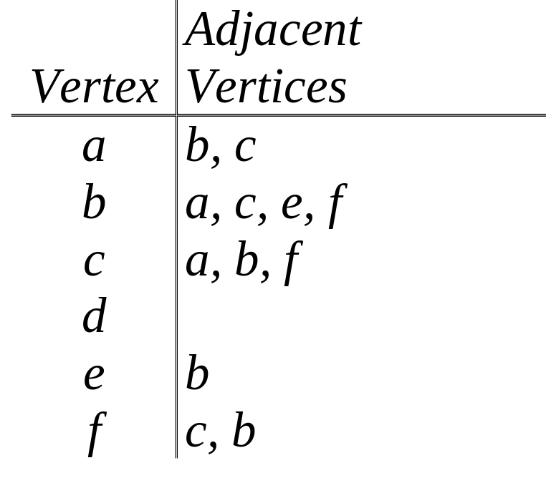
Adjacency Lists
A table with 1 row per vertex, listing its adjacent vertices.
a
b
c
d
e
f
(c)2001-2003, Michael P. Frank, revised by S. Kang

Slide 25
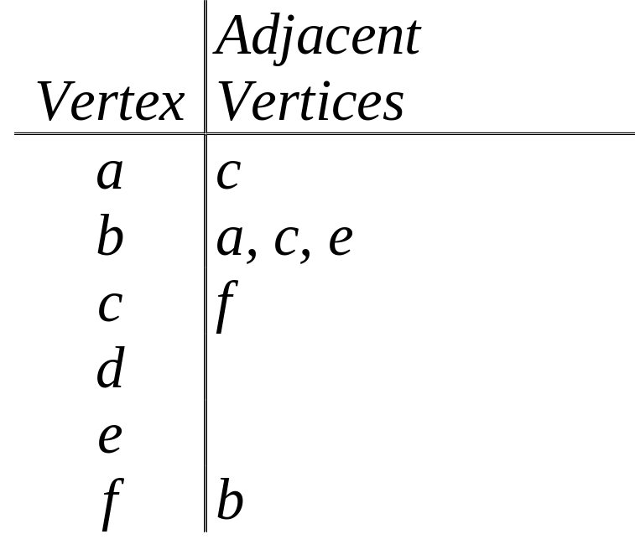
Directed Adjacency Lists
1 row per node, listing the terminal nodes of each edge incident from that node.
a
b
c
d
e
f
(c)2001-2003, Michael P. Frank, revised by S. Kang

Slide 26
Adjacency Matrices
A way to represent simple (not multi-) graphs
  possibly with self-loops.
Matrix A=[a_{ij}], where a_{ij} is 1 if {v_{i}, v_{j}} is an edge of G, and is 0 otherwise.
(c)2001-2003, Michael P. Frank, revised by S. Kang

Slide 27
Graph Isomorphism
Formal definition:
  Simple graphs G₁=(V₁, E₁) and G₂=(V₂, E₂) are isomorphic iff ∃ a bijection f:V₁→V₂ such that ∀ a,b∈V₁, a and b are adjacent in G₁ iff f(a) and f(b) are adjacent in G₂.
  f is the “renaming” function between the two node sets that makes the two graphs identical.
(c)2001-2003, Michael P. Frank, revised by S. Kang

Slide 28
Isomorphism Example
If isomorphic, label the 2nd graph to show the isomorphism, else identify difference.
d
b
a
b
a
d
c
e
e
c
f
f
(c)2001-2003, Michael P. Frank, revised by S. Kang

Slide 29
Are These Isomorphic?
If isomorphic, label the 2nd graph to show the isomorphism, else identify difference.
Same # of vertices
a
b
Same # of edges
Different # of verts of degree 2!
(1 vs 3)
d
c
e
(c)2001-2003, Michael P. Frank, revised by S. Kang

Slide 30
§8.4: Connectivity
In an undirected graph, a path of length n from u to v is a sequence of adjacent edges going from vertex u to vertex v.
A path is a circuit if u=v.
A path traverses the vertices along it.
A path is simple if it contains no edge more than once.
(c)2001-2003, Michael P. Frank, revised by S. Kang

Slide 31
Paths in Directed Graphs
Same as in undirected graphs, but the path must go in the direction of the arrows.
(c)2001-2003, Michael P. Frank, revised by S. Kang

Slide 32
Connectedness
An undirected graph is connected iff there is a path between every pair of distinct vertices in the graph.
Theorem: There is a simple path between any pair of vertices in a connected undirected graph.
Connected component: connected subgraph
(c)2001-2003, Michael P. Frank, revised by S. Kang

Slide 33
Directed Connectedness
A directed graph is strongly connected iff there is a directed path from a to b for any two verts a and b.
It is weakly connected iff the underlying undirected graph (i.e., with edge directions removed) is connected.
Note strongly implies weakly but not vice-versa.
(c)2001-2003, Michael P. Frank, revised by S. Kang

Slide 34
§8.5: Euler & Hamilton Paths
An Euler circuit in a graph G is a simple circuit containing every edge of G.
An Euler path in G is a simple path containing every edge of G.
A Hamilton circuit is a circuit that traverses each vertex in G exactly once.
A Hamilton path is a path that traverses each vertex in G exactly once.
(c)2001-2003, Michael P. Frank, revised by S. Kang

Slide 35
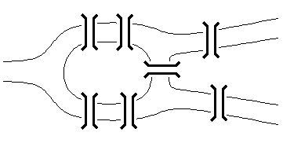
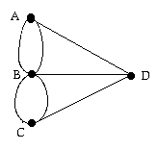
Bridges of Königsberg Problem
Can we walk through town, crossing each bridge exactly once, and return to start?
A
B
D
C
Equivalent multigraph
The original problem
(c)2001-2003, Michael P. Frank, revised by S. Kang

Slide 36
Euler Circuit/Path Theorems
Theorem: A connected multigraph has an Euler circuit iff each vertex has even degree.
Theorem: A connected multigraph has an Euler path (but not an Euler circuit) iff it has exactly 2 vertices of odd degree.
  One is the start, the other is the end.
(c)2001-2003, Michael P. Frank, revised by S. Kang

Slide 37
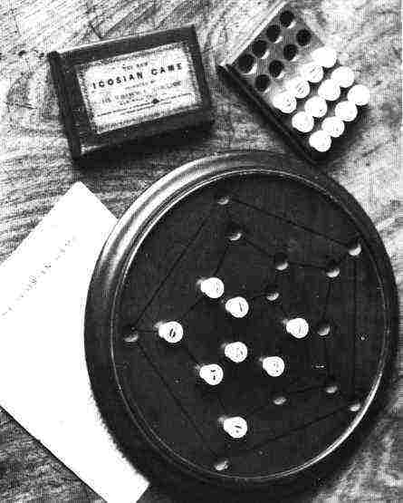
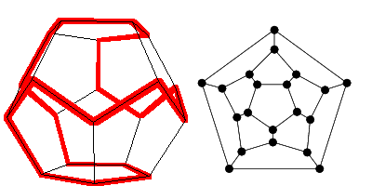
Round-the-World Puzzle
Can we traverse all the vertices of a dodecahedron, visiting each once?`
Equivalent
graph
Dodecahedron puzzle
Pegboard version
(c)2001-2003, Michael P. Frank, revised by S. Kang

Slide 38
Hamiltonian Path Theorems
Dirac’s theorem: If (but not only if) G is connected, simple, has n≥3 vertices, and ∀v deg(v)≥n/2, then G has a Hamilton circuit.
  Ore’s corollary: If G is connected, simple, has n≥3 nodes, and deg(u)+deg(v)≥n for every pair u,v of non-adjacent nodes, then G has a Hamilton circuit.
(c)2001-2003, Michael P. Frank, revised by S. Kang

